Slide 1


Marathwada Mitra mandal’s
COLLEGE OF ENGINEERING
Karvenagar, Pune
An Autonomous Institute
Presentation
On
Educational Platform Enhancement

Slide 2
Group Information
Sr.No | Prn No | Name of students
1 | B24IT1051 | Sairam Pampatwar
2 | B24IT1127 | Aditya Patil
3 | B24IT1053 | Ranveer Shinde
4 | B24IT1055 | Shivam Mandhani

Slide 3
Introduction
Traditional platforms lack engagement and personalization.
Our solution: a dynamic, accessible, learner-focused educational platform.
Users: Students, educators, administrators.
Goal: Enhance user satisfaction and educational outcomes.
What Makes This Platform Different?
AI integration for personalized learning recommendations.
Seamless user flow with responsive mobile-first design.
Emphasis on accessibility and inclusivity for diverse learners.
End Goal:
Build a system that not only teaches but also guides, adapts, and motivates each learner uniquely.

Slide 4
Objectives:
1. Improve user engagement through intuitive and accessible design:
Create a clean and uncluttered interface to reduce cognitive load.
Ensure seamless navigation to help users find content quickly.
Optimize the platform for mobile devices to cater to on-the-go learning.
Incorporate interactive elements (quizzes, polls, etc.) to increase active participation.
Design with accessibility in mind, adhering to WCAG guidelines.
2. Enhance learning outcomes with interactive and personalized features:
Implement AI-driven personalized learning paths that adapt to individual progress.
Provide adaptive quizzes and tests that adjust difficulty based on performance.
Offer detailed feedback and performance analytics to help learners identify strengths and weaknesses.
Integrate tools for bookmarking, note-taking, and content summarization to support effective studying.
3. Streamline course navigation and content consumption:
Organize course content in a logical and intuitive manner.
Use clear visual cues and labels to guide users through the platform.
Optimize content delivery for various formats (video, text, etc.) and devices.
Provide robust search and filtering options to help users find relevant resources.

Slide 5
Feature (Module Description)
1)Key UX Issues Identified Bullet Points:
Navigation Issues: Complex menus and cluttered dashboards make course discovery difficult.
Engagement Challenges: Passive content (videos) leads to disengagement.
Lack of Personalization: No tailored recommendations or adaptive learning paths.
Progress Tracking: Unclear visual progress feedback.
Community Features: Limited interaction spaces for peer support.
2)AI Features
AI-Powered Personalized Learning Paths
Smart Tutor / Chatbot Assistant
Automated Grading and Feedback
Predictive Analytics
Voice-to-Text & Text-to-Speech
Plagiarism Detection
Content Summarization & Highlighting
Image Recognition for Assignments

Slide 6
Functional and non-functional requirement
Functional requirement :
1.Adaptive test generation.
2.Interactive quizzes and revision tools
3.Subject-wise performance analysis
4.Bookmark & note-taking tools
Non-functional requirement :
1.Low-latency streaming even on 3G networks
2.24/7 uptime during peak exam seasons
3.Data privacy for minors (GDPR-compliant)
4.Mobile-first design (90% users on phones)

Slide 7
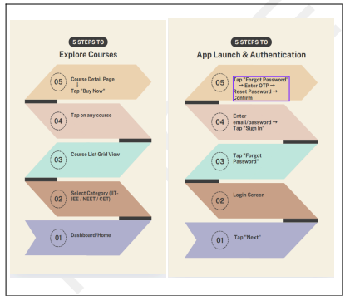
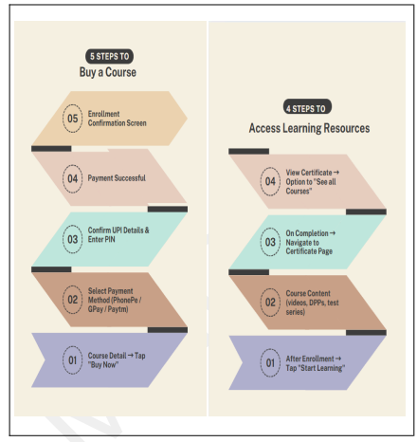
Task Flow

Slide 8
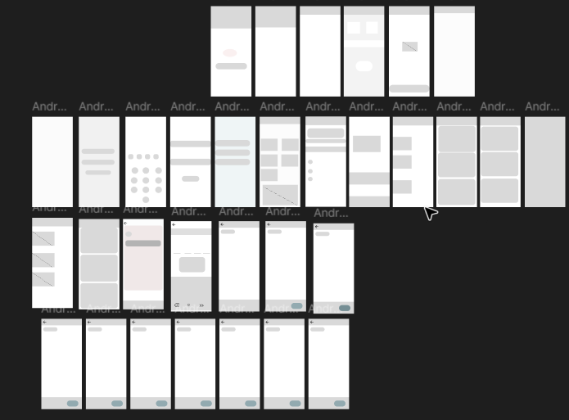
Low-Fidelity Wireframes

Slide 9
Link of Prototype
Prototype
video link
Github

